Slide 2
The External Economic Action of the European Union and the Sustainable Development Goals
Filippo Fontanelli – University of Edinburgh – filippo.fontanelli@ed.ac.uk
University of Bologna
3 May – 25 May
17 May 2023
Controlling inbound and outbound flows

Slide 3
Outline of the module (in progress)
The course’s basic coordinates
  Trade law, investment law and sustainable development: basic notions
  EU competences and policies in trade and investment law
Trade/investment obligations and non-trade values: the return of unilateralism
  The backlash against investor-State arbitration.
  The backlash against trade liberalisation
  Reform proposals for the global investment and trade regimes
  An overview of re-nationalisation trends in trade an investment (US, EU, UK, China)
    Anti-coercion
    Anti-circumvention
    Retaliate against non-MPIA
    Steel row, now sustainable
EU’s external economic action to raise standards abroad
  Free trade agreements and non-economic standards
    Conflict mineral regulation (sort of like diamonds)
    2022 commitment to green trade partnership
    Deforestation MERCOSUR
  Zoom-in: EU dispute with Korea on labour rights
  Zoom-in: level playing field and sustainable development in the Trade and Cooperation Agreement between the EU and the UK
    Mirror clauses
The Carbon Border Adjustment Mechanism
  Overview and assessment of the scheme
  Compatibility with WTO law (China’s complaint at WTO)
  Bonus: carbon removal
Energy (trade)
  EU Net Zero Industry Act and support to renewable energy industry (with assessment of WTO compatibility)
  Reaction to comparable foreign plans (US IRA)
  Zoom-in: biofuels and e-fuels
Energy (investments)
  Foreign investment protection and the fossil fuels industry
  Foreign investment protection and the nuclear energy industry
  Foreign investment protection and the renewable energy industry
  The Energy Charter Treaty, its reform attempts and the withdrawal of EU MS
Controlling trade and investment inbound and outbound flows
  Export restrictions and export controls (including coordinated action with US)
  Critical Raw Materials Act
  EU investment screening
Improving supply chains’ sustainability
  Friend-shoring and sustainable value chains
  Global supply chain due diligence proposal
  EU Guidance to Combat Forced Labor in Supply Chains
  Responsible forestry proposal (trade in forest-risk commodities)
  WTO law-compatibility of these schemes
Promotion of other social interests
  Non-paper of the Commission services 2017 TSD chatpers
  Gender balance in corporate governance in FTAs
  Protection of indigenous peoples’ rights
UNA Europa presentation

Slide 4


Outline
Export restrictions
  Effects and regulation
  US/EU practice
  Chinese practice
  Raw Materials
Investment screening
  Effects and regulation
  EU practice
UNA Europa presentation

Slide 5
What’s going on?
UNA Europa presentation

Slide 6


Slide 7

Export controls: the goals (classic)
Domestic goal: restrict exports to insulate domestic prices from international price shocks. The short-term strategy is to prevent high global prices from reaching the vulnerable, in order to avoid hunger, social unrest and political instability.
See https://www.bruegel.org/blog-post/food-security-role-and-limits-international-rules-export-restrictions
UNA Europa presentation

Slide 8
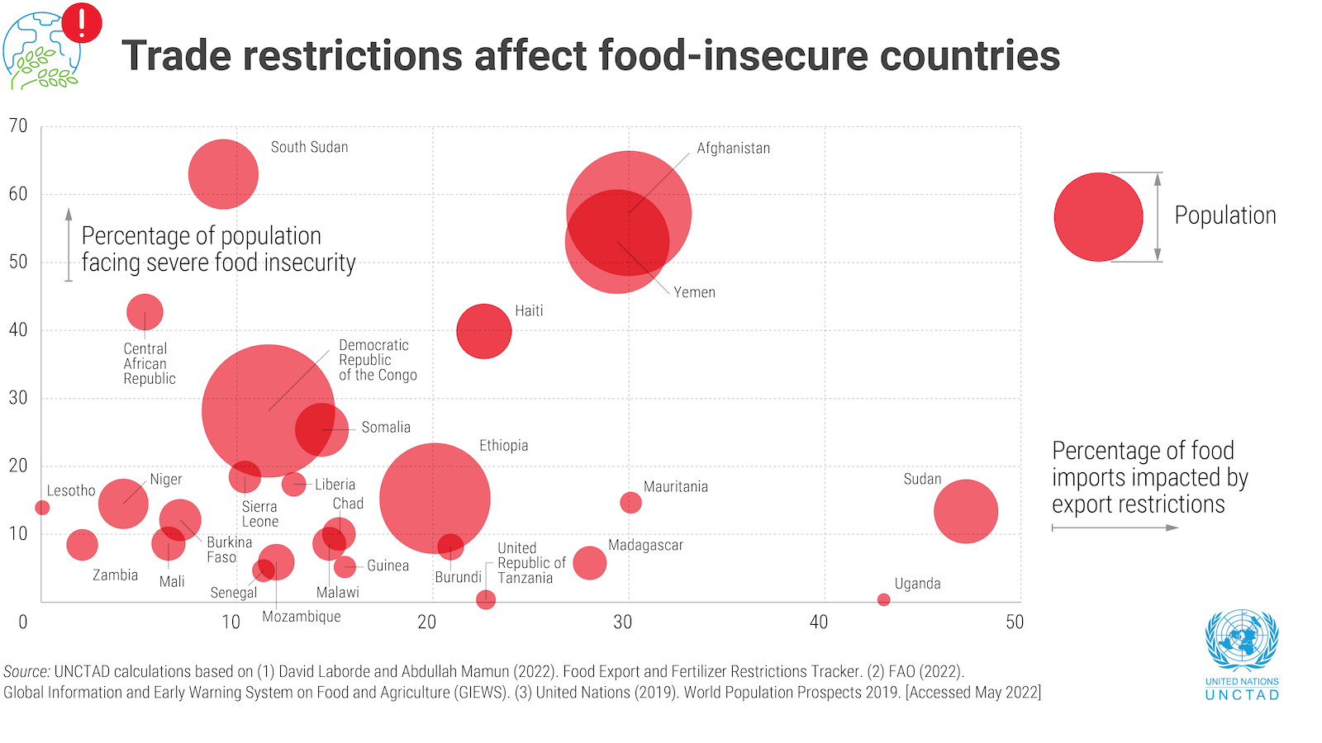
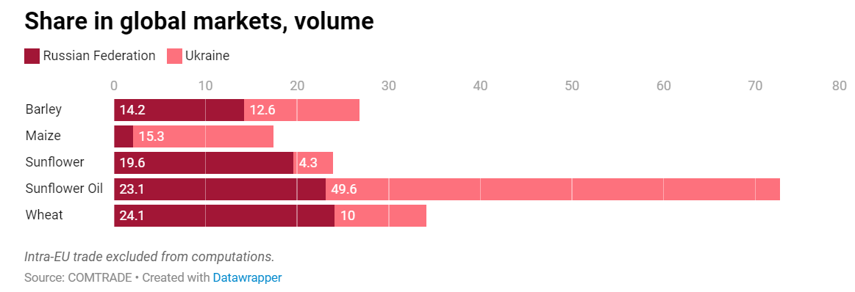
Export restrictions, the effects
External effects: raise global prices, disrupting supply chains, fuelling abroad same problems addressed locally

Slide 9
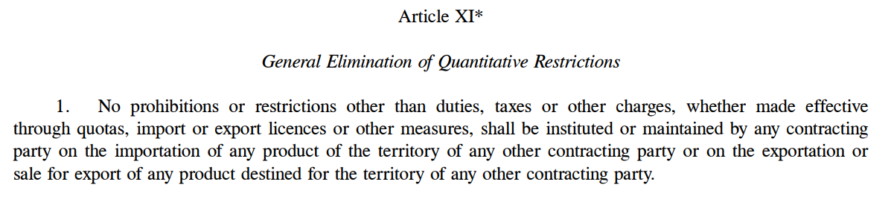
Export restrictions: the rule
UNA Europa presentation

Slide 10
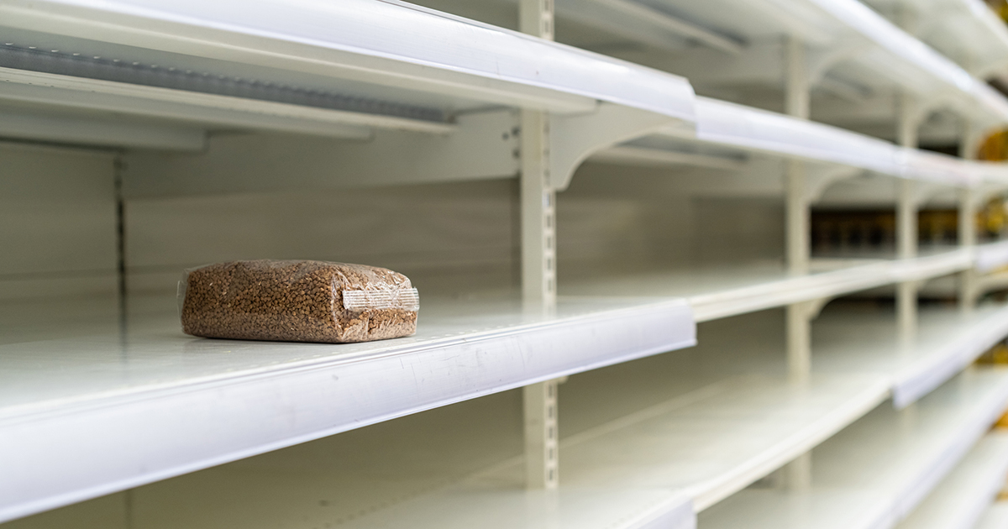
Export restrictions: the exceptions
Export prohibitions or restrictions temporarily applied to prevent or relieve critical shortages of foodstuffs or other products essential to the exporting contracting party
UNA Europa presentation

Slide 11
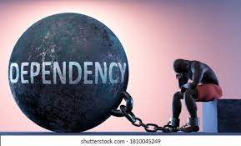
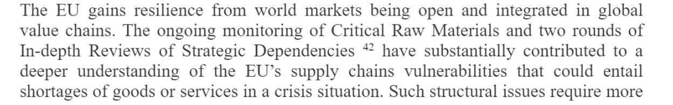
Sustainable value chains
A special kind of shortage: dependency
UNA Europa presentation

Slide 12
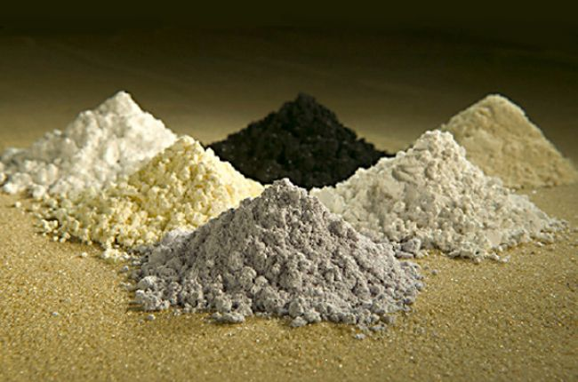
China export restrictions
WTO disputes relating to export restrictions on rare earths.
“Although such restrictions may have negative consequences for upstream extraction firms, China is able to implement the restrictions because several upstream firms are state-owned enterprises. As a result, China is able to utilize export restrictions on minerals and other raw materials effectively to foster the development of strategic emerging industries downstream”
https://www.cambridge.org/core/journals/world-trade-review/article/abs/chinas-export-restrictions-and-the-limits-of-wto-law/

Slide 13

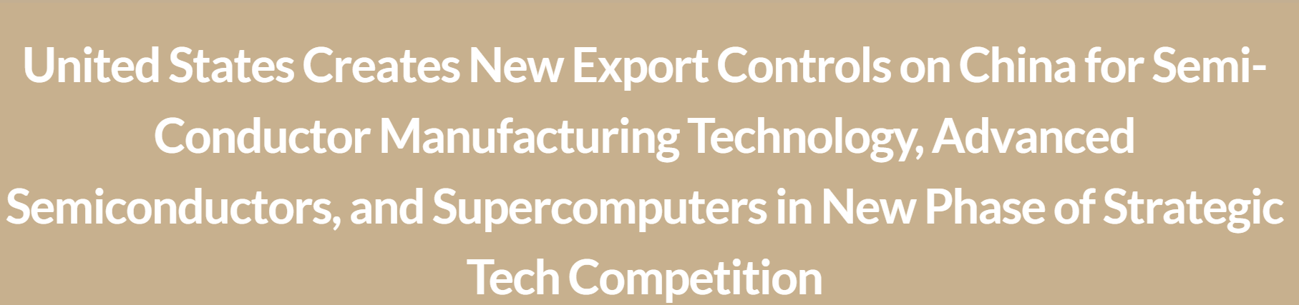
US export restrictions
Sanctions against Russia
Exports towards China

Slide 14

The war on chips
Export Control Reform Act
U.S. national security “requires that the United States maintain its leadership in the science, technology, engineering, and manufacturing sectors, including foundational technology that is essential to innovation,” and that “such leadership requires that United States persons are competitive in global markets.” Congress passed ECRA in large part due to concerns about Chinese technological advancement.
https://carnegieendowment.org/2022/04/25/evolution-of-u.s.-thinking-and-policy-pub-86898

Slide 15
The war on chips

Slide 16
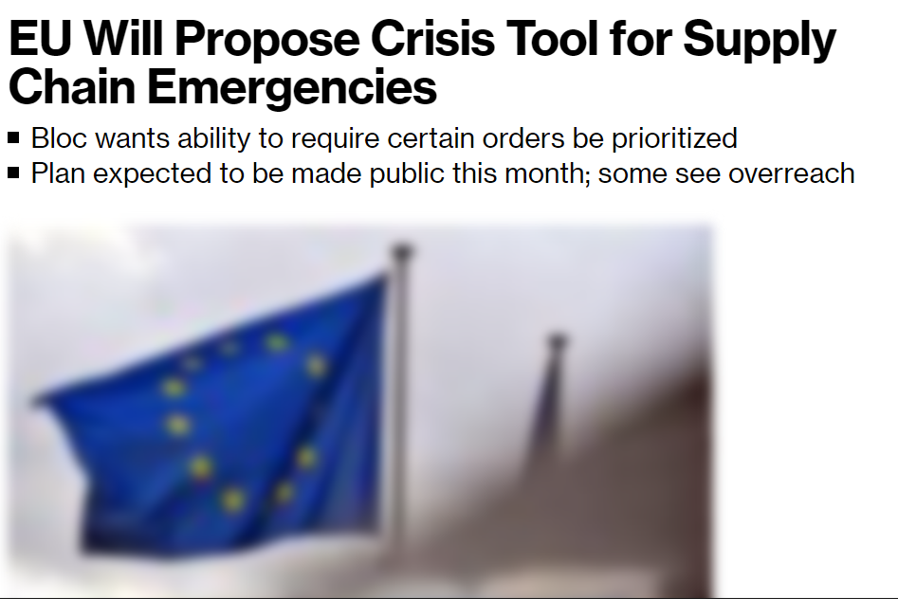
EU and export restrictions

Slide 17
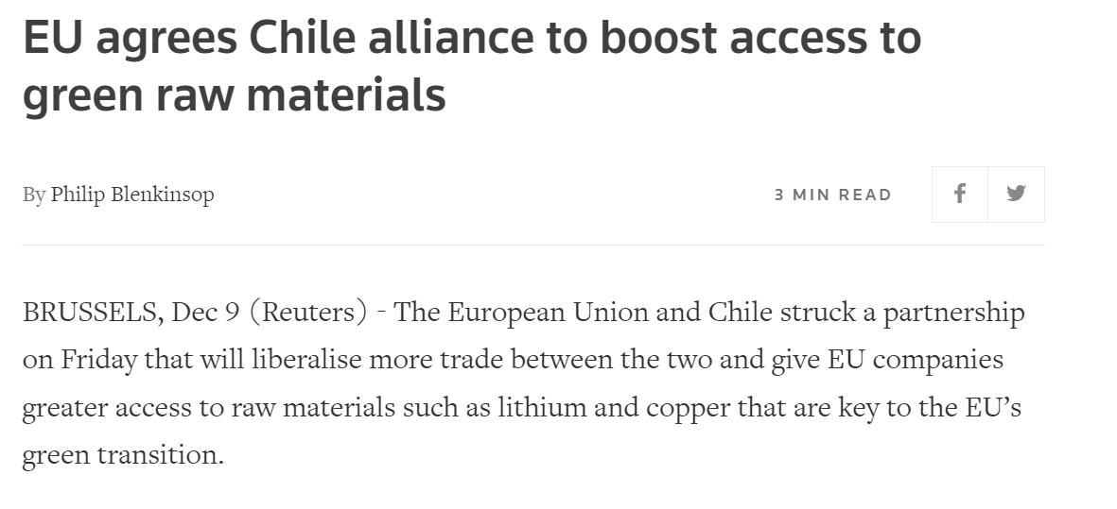
EU (and others) locking in preferential access

Slide 18

Critical Raw Materials
https://www.politico.eu/article/critical-raw-materials-act-europe-guide/

Slide 19
EU Critical Raw Materials Act

Slide 20
CRM Act
Domestic and external policies:
Boost domestic production, refining and recycling;
Diversify imports;
Free trade agreements containing CRM chapters;
Challenge: EU investment abroad (tariffs are already low);
Less redtape, possible state aids
UNA Europa presentation

Slide 21

Investment screening in the EU

Slide 22
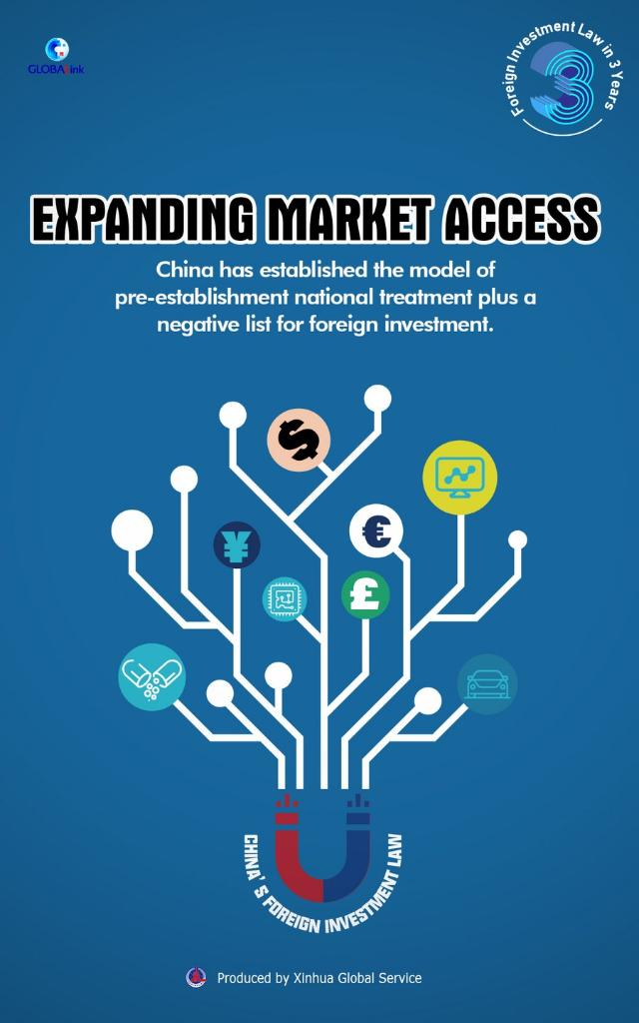
Pre-establishment guarantees
Most investment treaties do not provide non-discrimination rights to thos willing to make an investment (they only protect investments once they’re made);
GATS can provide market access and NT to Mode 3 (commercial presence)
UNA Europa presentation

Slide 23
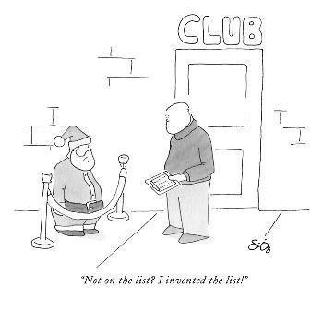
Avoiding foreign control on strategic industries
Positive lists
Negative lists
UNA Europa presentation

Slide 24

EU’s opening in FTAs
Pre-establishment guarantees, e.g., in deals with:
Montenegro, Georgia, Ukraine, Moldova
Canada
Japan
UNA Europa presentation

Slide 25
EU screening mechanism
Competence with MS
EU coordinates
Grounds: national security and public order
Further goals: curb undue foreign influence (coercion)
Voon, T., Merriman, D., 2022. Incoming: How International Investment Law Constrains Foreign Investment Screening. The Journal of World Investment & Trade 24, 75–114.
UNA Europa presentation

Slide 26

Relevant factors:
Critical infrastructures, including energy;
Critical technology including semiconductors, energy storage, nuclear;
Investor is State-owned or controlled
UNA Europa presentation

Slide 27
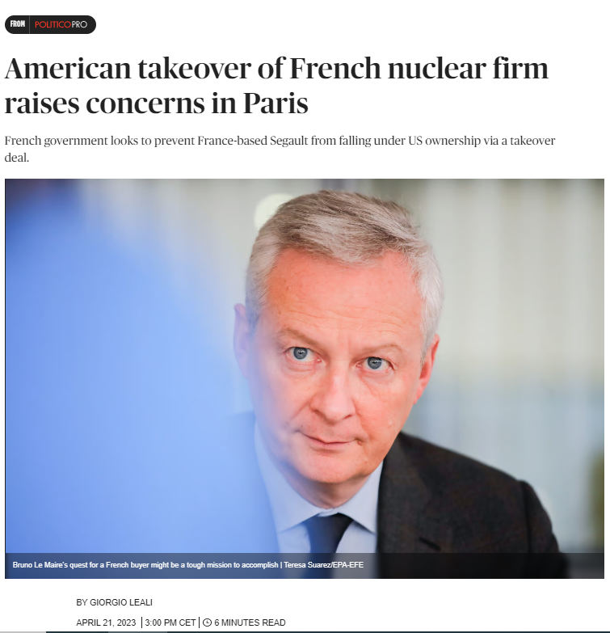
Domestic application

Slide 28
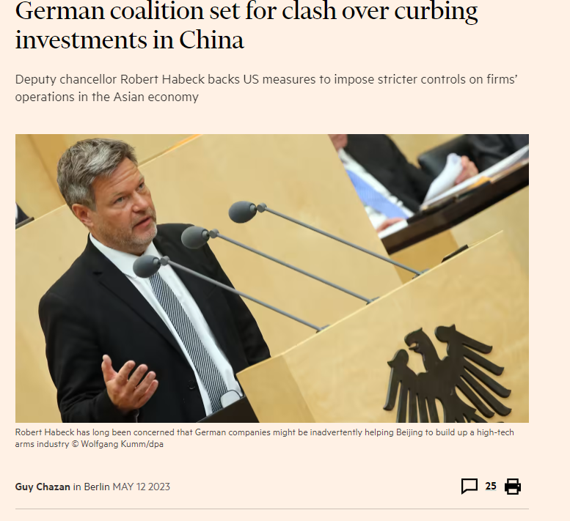
Next stop: outbound screening?

Slide 29
@una_europa
#Una_Europa
Thanks!

